Slide 1
Lesson 8: Stacks and Queues
by Dr. Shafqat Ali Shad

Slide 2
Wholeness of the Lesson
Stacks and Queues are, essentially, special kind of lists with a highly restricted interface that permit rapid insertion and rapid access to elements, according to a "last in, first out" (Stacks) or "first in, first out" (Queues) scheme. These data structures express the MVS principle that creation emerges in the collapse of infinity to a point.

Slide 3
The Stack ADT
Definition: A Stack is a List in which insertions and deletions can occur relative to just one designated position (called the top of the stack).
Operations:
pop | remove top of the stack and return this object)
push | insert object as new top of stack
peek | view object at top of the stack without removing it

Slide 4
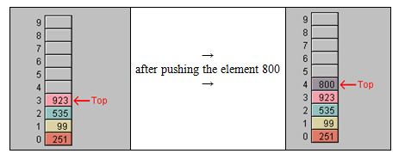
The Stack ADT
Model
The Stack operations (under usual implementations) are extremely efficient.

Slide 5
Implementation of Stack Using a Linked List
The usual add operation in a LinkedList adds the new element to the front of the list. Therefore, the push operation can be implemented by simply calling the Linked List’s add operation.
The peek operation is equivalent to find0th (in a LinkedList, it is the call get(0)).
The pop operation is equivalent to find0th followed by a call to remove(0).

Slide 6
Implementation of Stack Using an Array
Usual strategy: Designate the rightmost array element to be the top of the stack.
Advantage: Avoids the usual cost of copying array elements that is required in insertion and deletion of arbitrary array elements
Disadvantage: If usage requires many more pushes than pops, the underlying array will have to be resized often, and this is costly
Detail: To avoid traversing the array in search of the current top of the Stack, maintain a pointer to the rightmost element.

Slide 7
Java's Implementation of Stack
The standard Java distribution comes with a Stack class, which is a subclass of Vector.
Vector is an array-based implementation of List. Therefore, for implementations that require many more pushes than pops, a stack based on a Linked List should be used.
Exercise: Implement your own class MyStringStack that uses MyStringLinkedList.

Slide 8
Application of Stacks: Symbol Balancing
A Stack can be used to verify whether all occurrences of symbol pairs (for symbol pairs like (), [], {}) are properly matched and occur in the correct order.
The following procedure can be used:
Begin with an empty Stack
Scan the text (will ignore all non-bracketing symbols)
When an open symbol is read, push it
When a closed symbol is read, pop the Stack –
if the stack is empty (so it can't be popped) report an error
if the popped symbol doesn't match the symbol just read, report an error
After scanning is complete, if the Stack is not empty, report an error

Slide 9
The Queue ADT
Definition. Like a Stack, a Queue is a specialized List in which insertions may occur only at a designated position (the back) and deletions may occur only at a designated position (the front).
Operations:
dequeue | remove the element at the front (usually also returns this object)
enqueue | insert object at the back
peek | view object at front of queue without removing it

Slide 10
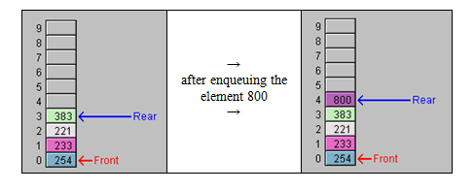
The Queue ADT
Running Times All operations, under a reasonable implementation, run in constant time (ie, so fast that running time does not depend on the number of elements in the queue)

Slide 11
Implementations of Queues
Using a Linked List
Implementation is straightforward
Good idea to use a circular Linked List to facilitate fast enqueuing
2. Using an Array
Need to maintain pointers to front and back elements
Repeated enqueuing will fill the right half of the array prematurely—solution is to wrap around to the front.

Slide 12
Implementations of Queues
Java's Implementation
No implementation available till j2se5.0
In j2se5.0, an interface Queue<E> (implemented by LinkedList<E>) is provided, with these declared operations:
E peek() -- returns but does not remove the front of the queue
void add(E obj) – same as enqueue
E remove() – returns and removes the front of the queue (same as dequeue)

Slide 13
MAIN POINTS
The Stack ADT is a special ADT that supports insertion of an element at “the top” and the removal of the top element, by way of operations push and pop, respectively. Similarly, the Queue ADT is a special ADT that supports insertion of an element at “the rear” (called enqueuing) and removal of an element from the “front” (called dequeuing). Both ADT’s, when implemented properly, are extremely efficient. Sun provides a Stack class and a Queue interface in its Collections API. Stacks and Queues make use of the MVS principle that the dynamism of creation arises in the concentration of dyamic intelligence to a point value ("collapse of infinity to a point"); stacks and queues achieve their high level of efficiency by concentrating on a single point of input (top of stack or rear of queue) and a single point of output (top of stack or front of queue).

Slide 14
CONNECTING THE PARTS OF KNOWLEDGE WITH THE WHOLENESS OF KNOWLEDGE
Collapse of infinity to a point embodied in Stacks and Queues
Lists may be used as an all-purpose collection class. Nearly any need for storing collections of objects can be met by using some kind of list, though in some cases, other choices of data structures could improve performance. Lists have a more "unbounded" range of applicability.
Stacks and Queues are extremely specialized data structures, designed to accomplish (primarily) two operations with optimum efficiency. These data structures have a restricted range of applicability that is like a "point".

Slide 15
CONNECTING THE PARTS OF KNOWLEDGE WITH THE WHOLENESS OF KNOWLEDGE
Transcendental Consciousness: Transcendental Consciousness is the unbounded value of awareness.
Wholeness moving within Itself: In Unity Consciousness, creation is seen as the teraction of unboundedness and point value: the unbounded collapses to its point value; point value expands to infinity; all within the wholeness of awareness.

Slide 16
Thank you

